Slide 1

Autonomous Vehicle: ROS Navigation in 5 Days
Submitted by:
Dor Dikman - 204178867
Tamar Entin – 210014411

Slide 2
Introduction
ROS (Robot Operating System): An open-source, flexible framework for writing robot software. Despite its name, it's not an operating system, but a set of libraries and tools for managing complex robot functions. It serves to abstract hardware, control low-level devices, manage package systems, and more, making the development process smoother and more efficient.
Rviz: A 3D visualization tool for robots. It presents a wide array of sensor data, displays robot models, and helps visualize environments. Its graphical interface is invaluable for developing and debugging robot controllers.
Autonomous Navigation: The ability of a robot or a vehicle to independently create and follow a route in its environment without requiring any human guidance or control.

Slide 3
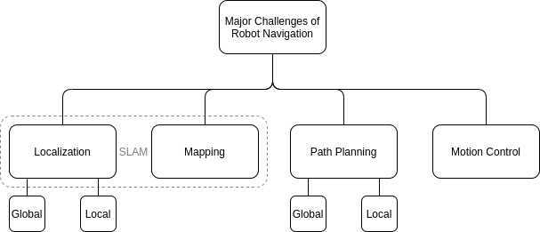
Autonomous Navigation Overview
Autonomous navigation involves several interlinked components that enable a robot to move independently:
Mapping: The robot should be able to build a virtual representation of its environment.
Localization: The robot needs to know where it is.
Path Planning: The robot needs to be able to plan a route.
Motion Control: The robot has to be able to use a planned path to navigate its environment while adjusting to any unexpected obstacles.

Slide 4
ROS Navigation Essentials
ROS Navigation Stack is a robust collection of software packages that facilitates autonomous navigation for a robot in ROS. This set of tools forms the backbone of robot navigation, ensuring the robot can efficiently and safely move within its environment.
To utilize the ROS Navigation Stack for autonomous navigation, several components are needed:
A Robot: Equipped with essential sensors like a laser range finder for mapping and an odometry sensor for tracking its movement.
ROS Software: A computer system running ROS and the ROS Navigation Stack.
An Environmental Map: A 2D representation of the environment where the robot will navigate.
Localization Mechanism: A method for determining the robot's location within the environment, commonly achieved with the AMCL package.
Path Planning: Algorithms to devise safe and efficient paths for the robot to follow.

Slide 5

Mapping
In order to perform robot navigation with ROS, the first step involves mapping, the creation of a detailed map of the environment. This map is essential to help the robot understand its surroundings.
Process of Mapping:
The robot moves around the environment.
As the robot navigates, it records data from its sensors such as a laser range finder.
This sensor data is utilized to generate a detailed representation of the environment.
Using mapping algorithms, the collected data is processed to create a 2D map.
The resulting map provides valuable information about the environment's features and obstacles.

Slide 6
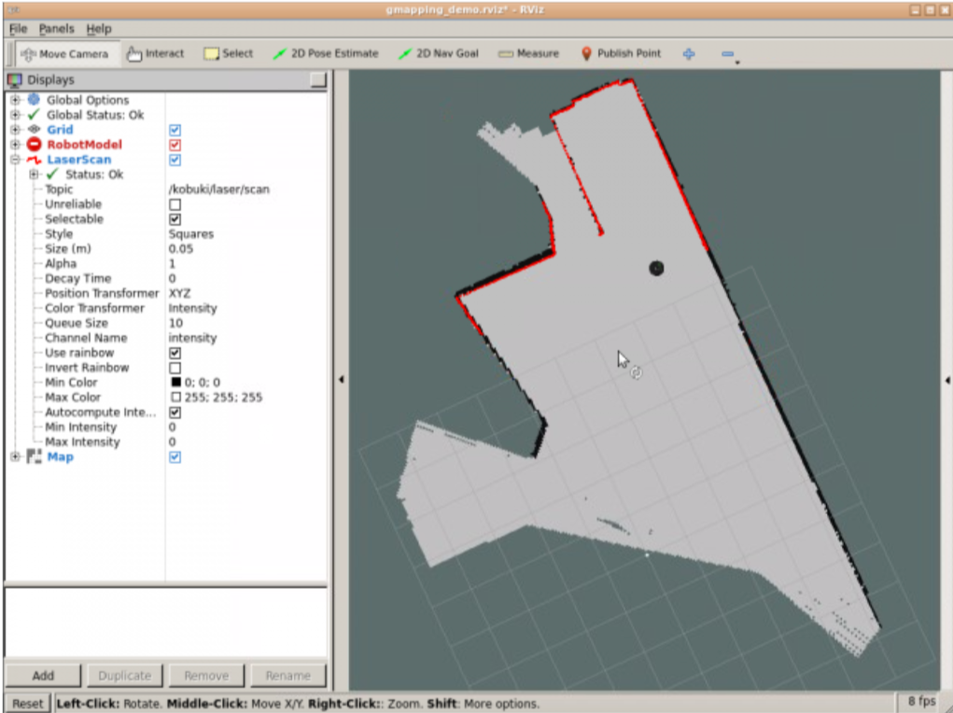
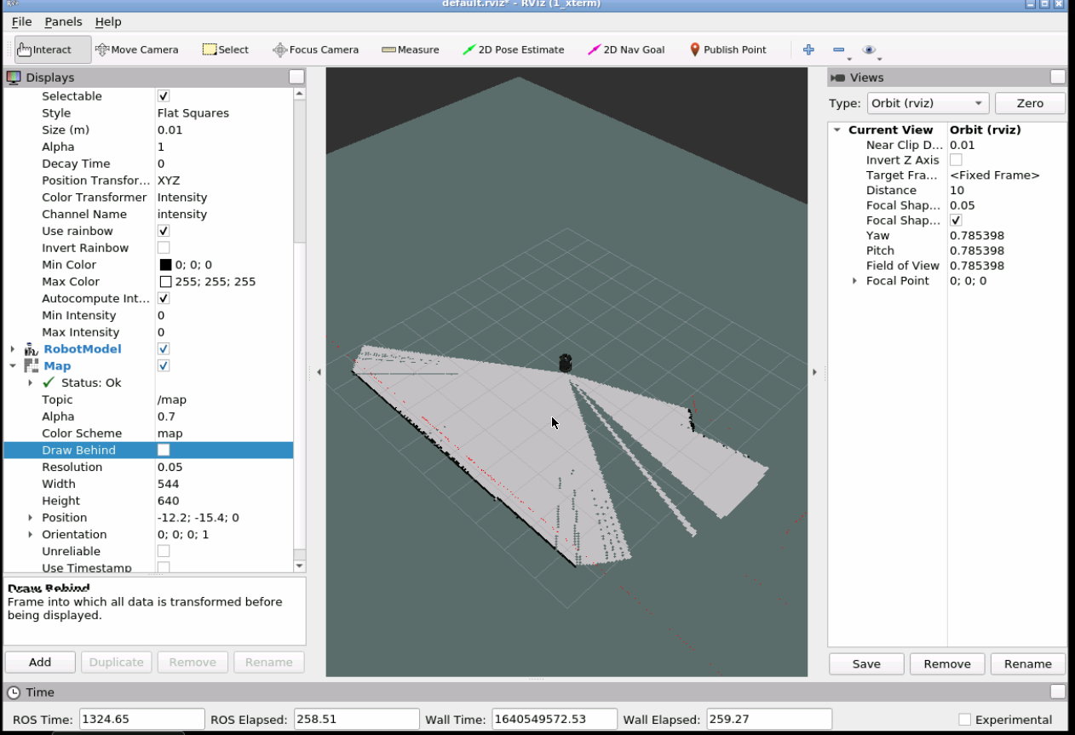
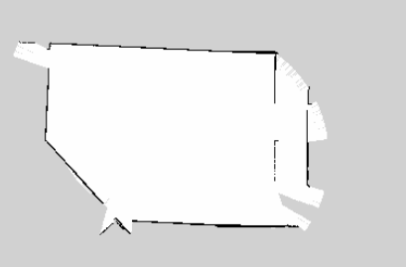
Mapping
The Robot is using a laser to map the surroundings
To provide a practical illustration of mapping, let's consider an example with the Kobuki robot.
Steps in the Process:
Launch the map builder program and the keyboard teleoperation program.
Manually move the robot around the environment.
As the robot moves, its sensors record data, which is processed in real-time to create a map.
This map can be viewed using RViz, a powerful visualization tool that provides a graphical interface for observing the mapping process.

Slide 7
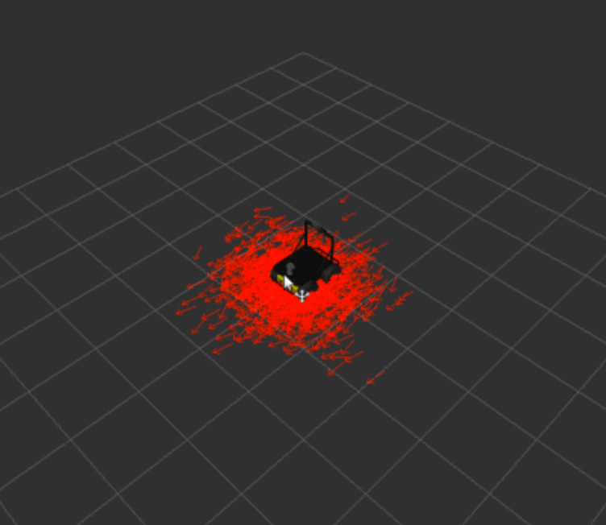
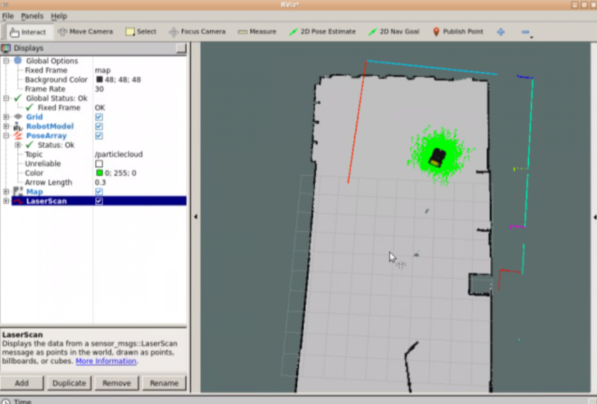
Localization
Localization in ROS Navigation refers to the process of determining the robot's position and orientation within a map. This is achieved through an algorithm known as Monte Carlo Localization (MCL).
The MCL algorithm starts by generating a set of hypotheses, or "particles," each representing a possible location and orientation of the robot.
The algorithm then continually refines these particles based on sensor data, converging on the robot's most probable pose within the map.
As the robot moves and gathers more data, the precision of this estimated pose improves.
Thus, localization is a vital component of autonomous navigation, ensuring the robot can effectively and efficiently navigate its environment.

Slide 8
Path Planning: Planners
Path planning is a two-stage process involving both a Global Planner and a Local Planner.
Global Planner: calculates a safe path from the robot's starting point to a goal defined by the user. The Global Planner uses global costmap data, a broad view of the environment, to design the path. Examples of Global Planners include Navfn and CarrotPlanner.
Local Planner: works with the plan from the Global Planner and formulates velocity commands for the robot based on its current position and sensor data from the local costmap. The local costmap represents the robot's immediate surroundings, aiding in safe navigation while avoiding obstacles.
Different types of planners are available for specific scenarios and robotic configurations, allowing for a high degree of customization in ROS Navigation.

Slide 9
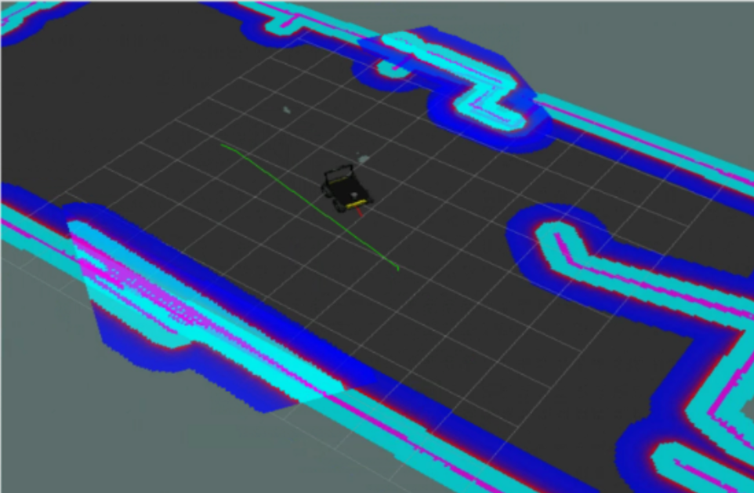
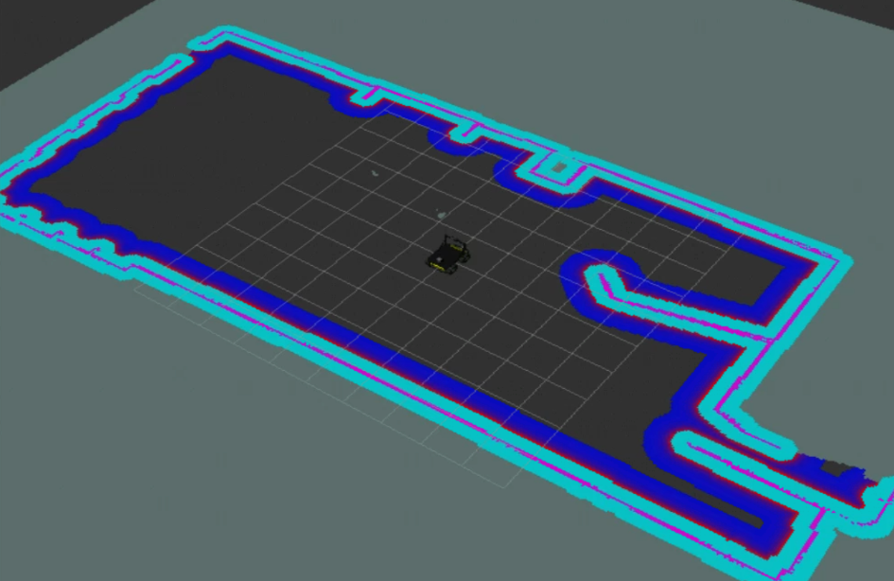
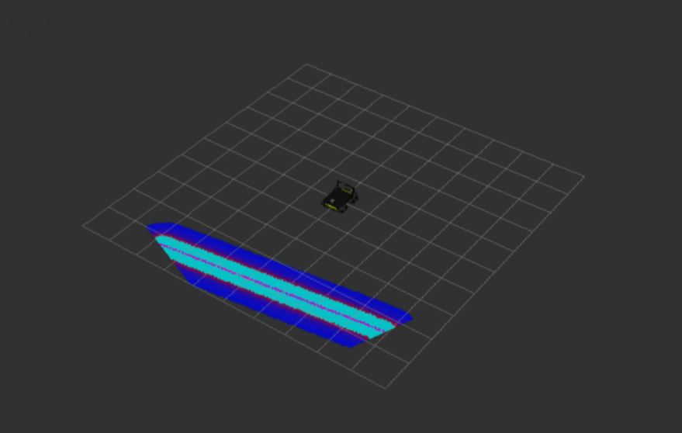
Path Planning: Methods and Tools
Various tools and methods are used in the path planning process:
Navfn: An example of a Global Planner, Navfn employs Dijkstra's algorithm to compute the shortest path between the starting and the goal point.
CarrotPlanner: Another Global Planner. If the goal point falls within an obstacle, CarrotPlanner traces back the path from the goal to the robot, adjusting the goal point to the nearest obstacle-free location.
Costmaps: These are 2D grid maps where each cell represents the safety of the space for the robot. For instance, a value of 0 represents free space without obstacles, meaning the robot can occupy that position without colliding with anything.
Together, these tools and methods allow for the generation of safe, efficient paths, facilitating smooth navigation for the robot in its environment.
Global Costmap
Local Costmap
Dijkstra Algorithm Visualization
Global plan – Green
Local plan - Red

Slide 10
Obstacle Avoidance
Obstacle avoidance in ROS Navigation is achieved through a collaborative effort between the Global and Local Planners.
The Global Planner initially calculates a path, but this path is not rigid and can be adjusted by the Local Planner.
The Local Planner makes use of the robot's sensor data to ensure the robot avoids collisions during its navigation.
Two key algorithms employed for this task are the Trajectory Rollout and Dynamic Window Approach (DWA), with DWA often preferred for its efficiency.
The 'move_base' node oversees all of these components, coordinating between the path planning system, costmaps, and recovery behaviors.
In situations where the robot is stuck or encounters unforeseen obstacles, recovery behaviors are triggered to aid navigation, such as rotating to better scan the environment or clearing the costmap to reassess the situation.

Slide 11
Summary
In this course we learned the key and essential concepts of ROS Navigation, which allow robots to move around autonomously in various fields: warehouses, domestic, entertainment.
The following concepts were learned:
Setup ROS Navigation Stack on a Robot
Building a map of the environment
Perform Robot Localization
Autonomous Path Planning
Understanding Localization and Mapping
Obstacle Avoidance

Slide 12
Video: https://drive.google.com/drive/folders/18-idL2IT_ypp4kdEGpUNuG5JNwAhQOQQ
Project: https://github.com/TamarEntin/Autonomous_Vehicle

